Slide 1

Speech Buddy
By William Anderson

Slide 2
Introduction
Speech Buddy is a voice interface intended to make storage and manipulation of data easier, as well as perform simple various tasks via voice commands. It is intended to make simple everyday tasks, such as adding items to your calendar, easier.
Speech Buddy was built using a Raspberry Pi 3 Model B, a USB microphone and a 3.5mm external speaker.
Speech Buddy uses Amazon Voice Services for it’s voice interface dependencies and libraries.

Slide 3
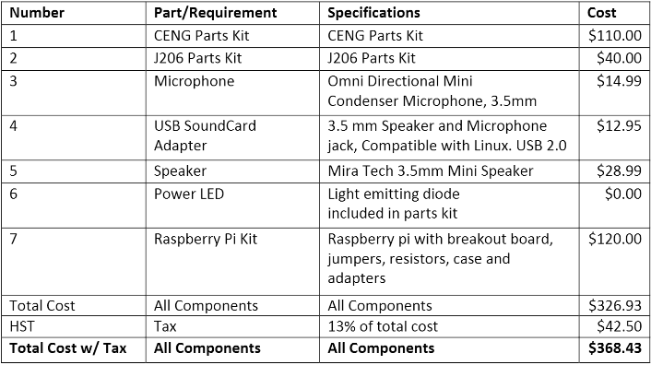
Speech Buddy’s Budget

Slide 4

Project Schedule

Slide 5

Speech Buddy Build Video

Slide 6
Knowledge Used from Previous Courses
Navigation and Operations on the Linux command line (CENG 200 – Unix Scripting
JavaScript/General Programming (CENG 256 – Internet Programming , TECH 104 – Programming Fundamentals)
Project Planning and Development Lifecycles (CENG 216 – Intro to Software Engineering)
Database Creation and Manipulation (CENG 254 – Database with Java)

Slide 7
FIN

